Slide 1



Phonics and Reading in Year 1…
Wednesday 4th October 2017
Welcome!

Slide 2


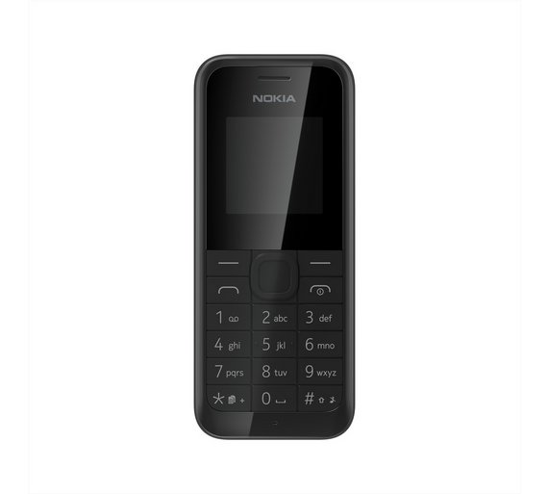
Housekeeping

Slide 3
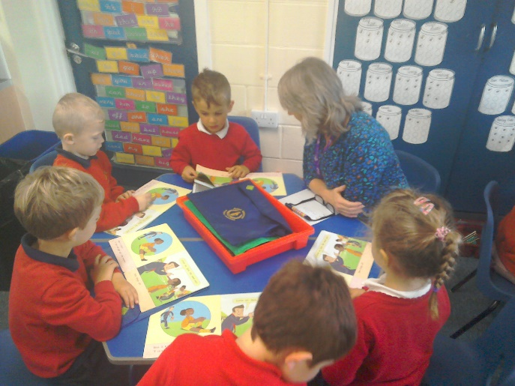
Overview
Learning to read
Phonics in Year 1…
Reading in Year 1…
Helping at home
Other information

Slide 4
1. Learning to read…

Slide 5
How did you learn to read?

Slide 6
ghoti
ghoti = fish
gh – “f” - cough
o – “i” - women
ti – “sh” - nation

Slide 7

Good word recognition, good language comprehension
+
Good language comprehension, poor word recognition
-
+
Good word recognition, poor language comprehension
Poor word recognition, poor language comprehension
-

Slide 8
2. Phonics
in Year 1

Slide 9
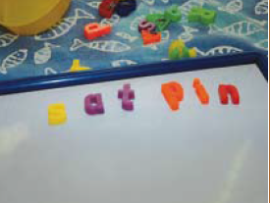
A systematic approach…
Phonics
Phonics is a method for teaching reading and writing of the English language by children learning sounds and linking them to letters.
A written language is basically a kind of a code. Teaching phonics is just teaching children to crack that code.

Slide 10
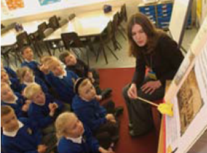
So what goes in to phonics?…
Phonics
Words are made up from small units of sound called phonemes. There are 44 sounds in the English language that we teach the children…
…however...we only have 26 letters in the alphabet so some graphemes are made up from more than one letter. Digraphs are two letters that make one sound (sh, ch, th).
Trigraphs are three letters that make one sound (air, ear, ure).

Slide 11
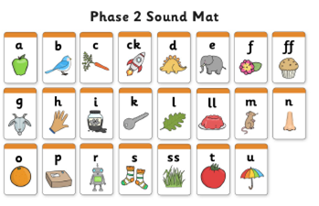
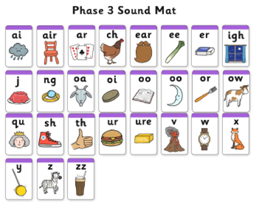
Linking letters and sounds
Phonics
1. GPC
Grapheme Phoneme Correspondence
Recapping

Slide 12
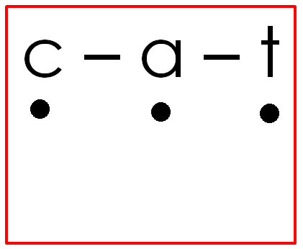
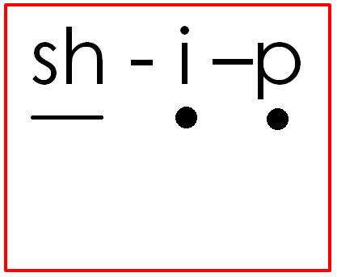
Main components of phonics…
Phonics
2. Blending…Reading…
Children do go past this stage but need to be able to use this strategy when reading an unfamiliar word.

Slide 13

Main components of phonics…
Phonics
3. Segmenting…Spelling
laptop
Children do go past this stage but need to be able to use this strategy when spelling an unfamiliar word.

Slide 14
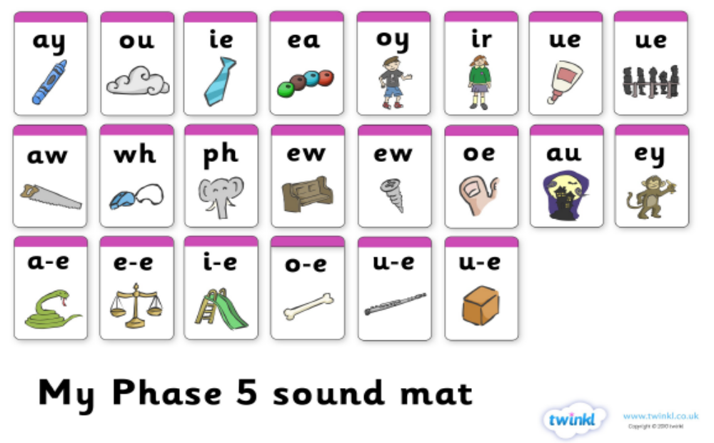
Teaching Phase 5
Phonics
New GPCs!
Introducing…

Slide 15
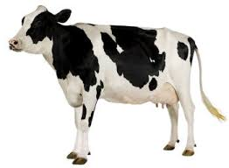

Teaching Phase 5
Phonics
Alternative sounds…
cow
cloud

Slide 16
Teaching Phase 5
Phonics
Split Digraphs
mad
made

Slide 17
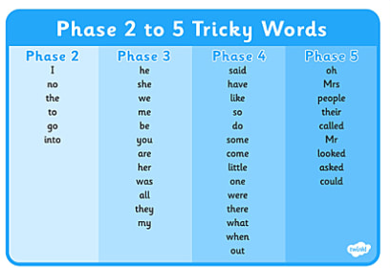
Teaching Phase 5
Phonics
New tricky words

Slide 18
3. Reading in Year 1

Slide 19
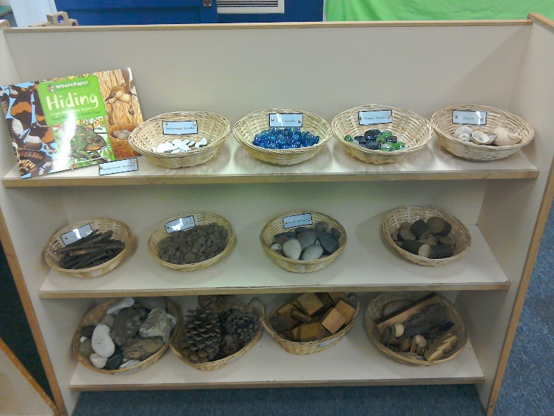
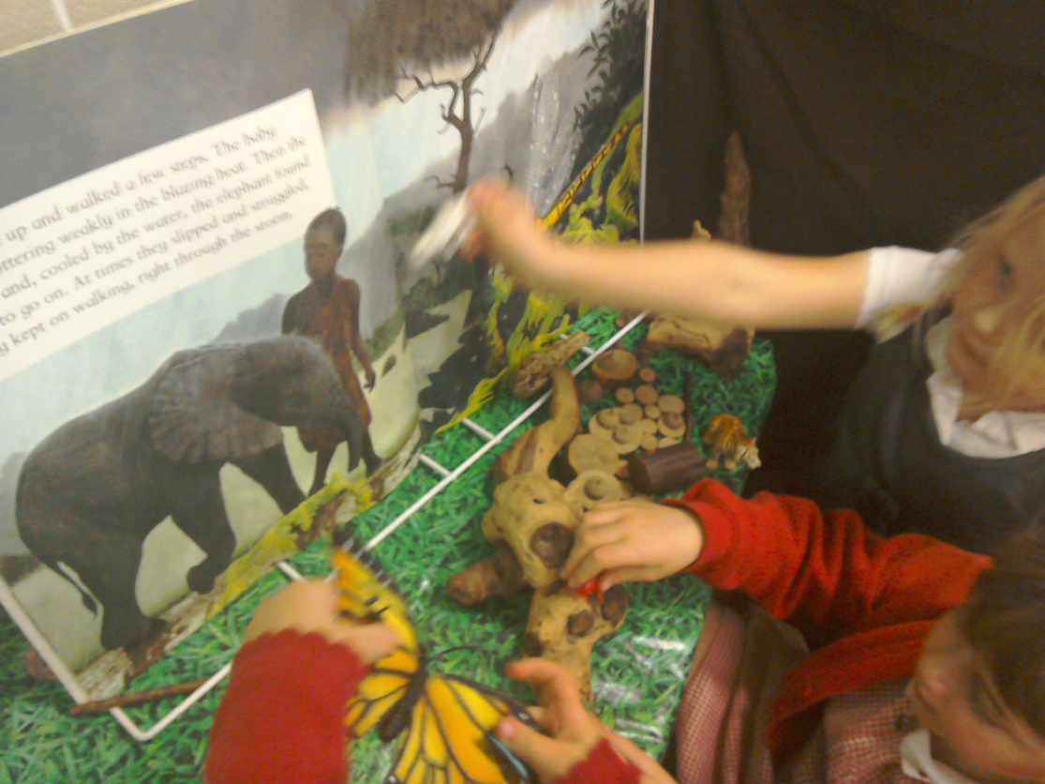
Provision to support reading…
We read to the children every day!
Children need a rich exposure to a wide range of vocabulary.

Slide 20

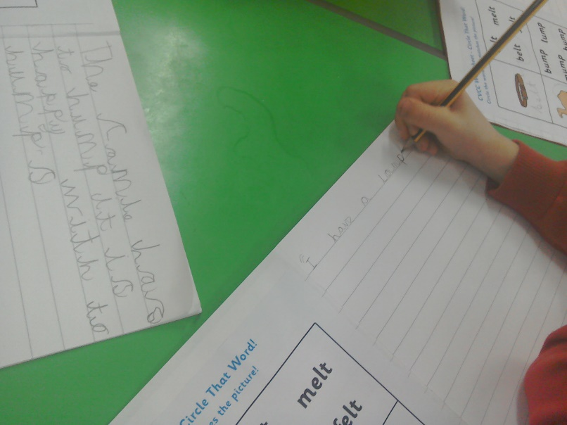
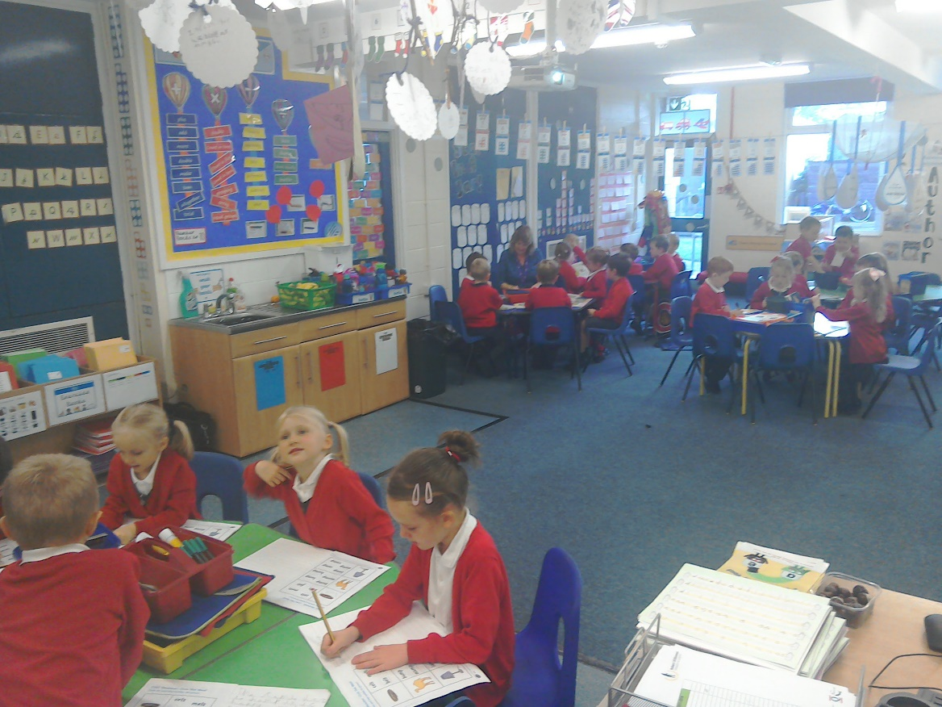
We read daily in Year 1 in small groups…
Children also do Phonics activities independently.

Slide 21
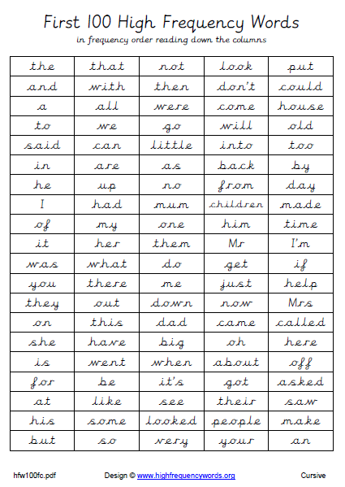
Beginning to read with pace & fluency…
Reading
in Year 1
1. First 100 High Frequency Words
Decodable
Not decodable
Children just have to learn these to memory!
Focus on spelling these words as well…

Slide 22
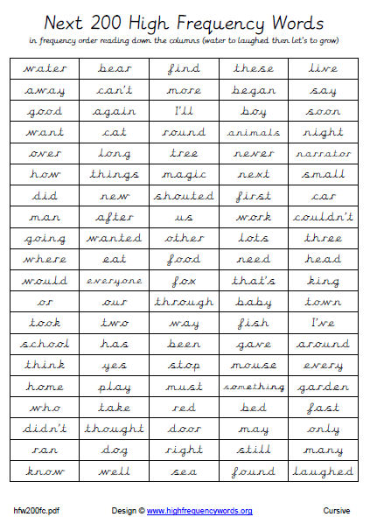
Beginning to read with pace & fluency…
Reading
in Year 1
2. Next 200 High Frequency Words

Slide 23
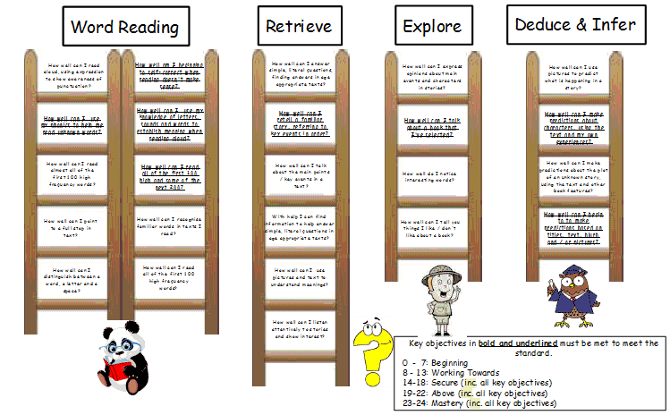
Comprehension
Reading
in Year 1

Slide 24
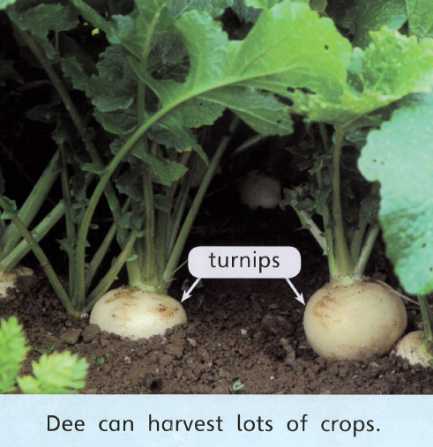
Comprehension
Do children understand what they are reading?!
Reading
in Year 1

Slide 25
What is retrieving?
Retrieve

Slide 26
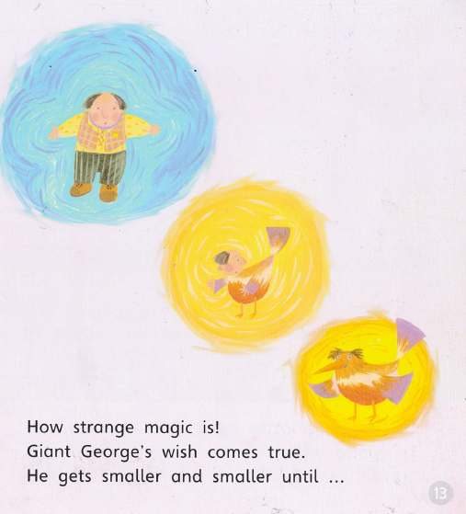
Retrieve
What is happening at this point in the story?
What is Giant George’s wish?
What happens when Giant George’s wish comes true’?
Tick one box.
He says magic is strange
He gets smaller and smaller
He gets bigger and bigger

Slide 27
What is exploring?
Explore

Slide 28
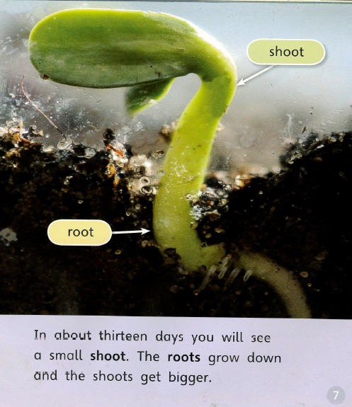
Explore
Why are some words written in bold in the text?
Where do the roots grow?
When will you see a small shoot’?
____________________

Slide 29
What is deducing
and inferring?
Deduce & Infer

Slide 30
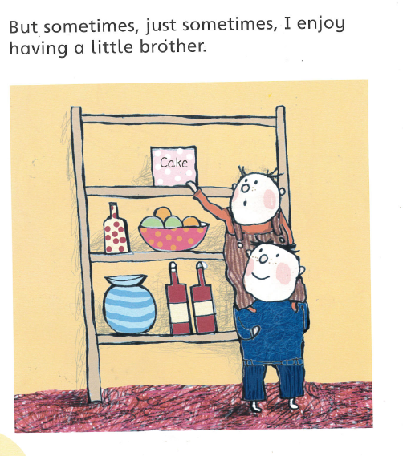
Deduce & Infer
How do you know that he enjoys having a little brother?
What might happen next?
How does Sam feel?
____________________

Slide 31
Vocabulary underpins everything we do!
Vocabulary Comparison

Slide 32
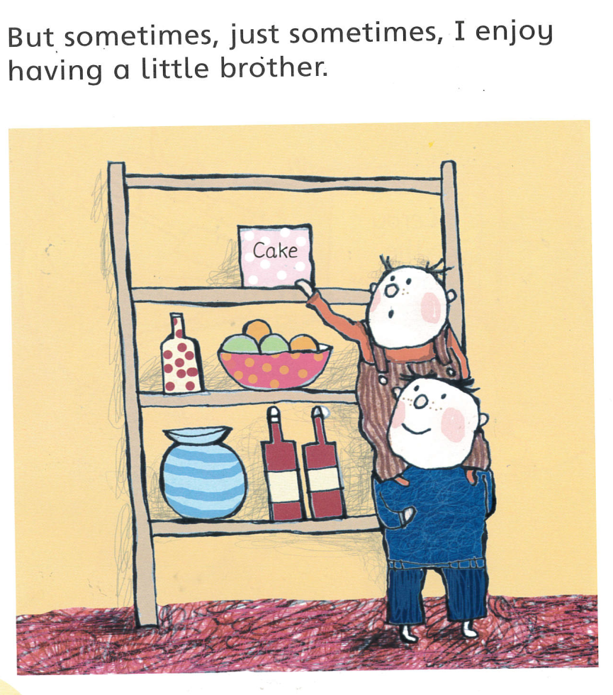
Vocabulary Comparison
What word means the same as like?
Can you think of other words that means the same as enjoy?
Which word or phrase means the same as ‘enjoy’?
Tick one box.
sad
enjoy
dislike

Slide 33
National phonics screening check …
Screening
Week commencing 11th June 2018
Really important that children are in school this week.
The National phonics screening check is a statutory assessment that was introduced in 2012 to all Year 1 pupils and is a quick and easy check of your child’s phonics knowledge.
What is in the phonics screening check?
It comprises of a list of 40 words and nonsense words. It will assess
phonics skills and knowledge learnt through reception and year 1.
Your child will read one‐one with a teacher and will be a familiar face. Your child will read up to 4 words per page and they will probably do the check
in 10‐15 minutes. They will be asked to ‘sound out’ a word and blend
the sounds together. The check is very similar to tasks the children
already complete during phonics lessons.

Slide 34
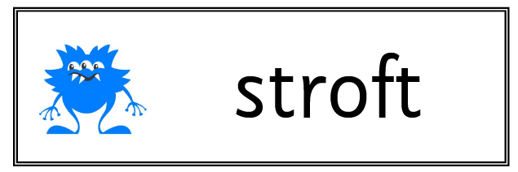
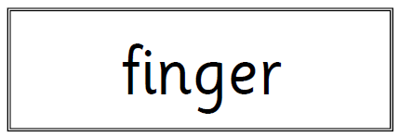
Word of the day
enroy
destroy

Slide 35
4. Helping at home

Slide 36
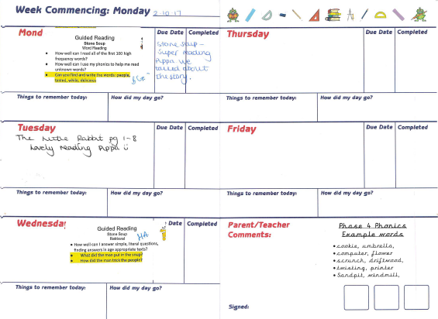
How can you help at home?
Help at home
Listen to your child read their guided reading and shared reading books.

Slide 37
How can you help at home?
Help at home
Keep an eye on your child’s planner and newsletters to stay up to date with our new sounds and words.
Use your imagination to practise High Frequency Words – cut them up and hide them, play snap etc.
Continue sharing stories with your child to encourage reading for pleasure.
Encourage your child to apply their reading skills in the wider world eg: reading subtitles on the TV, menus in restaurants.

Slide 38
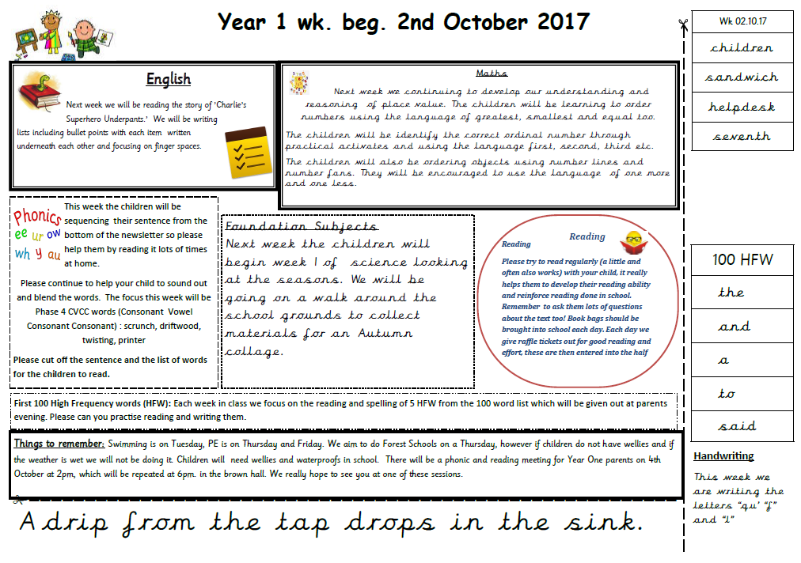

Slide 39

Top tips for helping at home…
Help at home
Keep it short and sweet!!!
Make it fun!
Keep talking…
Keep it balanced.
PhonicsPlay - Phonics games, planning, assessments and printables

Slide 40
Other info…

Slide 41
Other info…
Forest Schools
Thursday Afternoons
Don’t forget to send in wellies for all children to take part in Forest Schools…
ICT
Practising mouse control…interacting with simple software.
Bloomz
Don’t forget to send back parent consent forms.
Peer Mentors
Start date TBC. Good attitude towards learning and behaviour. 6 per Half-Term per class
Reading Helpers
Mon-Fri
If you would like to help children read in Year One please sign up on the A3 forms. More information will follow soon.
Swimming
Tuesdays
Don’t forget to send in their swimming kits please…

Slide 42
Any questions?
Thanks for listening ☺

